Slide 1

Retail Analytics and Forecasting – a Machine Learning Approach
DATA 606 CAPSTONE
Prof. Dr. Chaojie (Jay) Wang
FINAL PROJECT PRESENTATION
Sruthi Kapudasi
SY86412

Slide 2

Table of Contents
Project Title
Introduction
Background
Dataset Overview
Research Questions
Expected Outcomes
EDA Insights
Dataflow Diagram
Model Training & Methodology
Model Comparison & Results
Streamlit Dashboard Overview
Future Enhancements

Slide 3
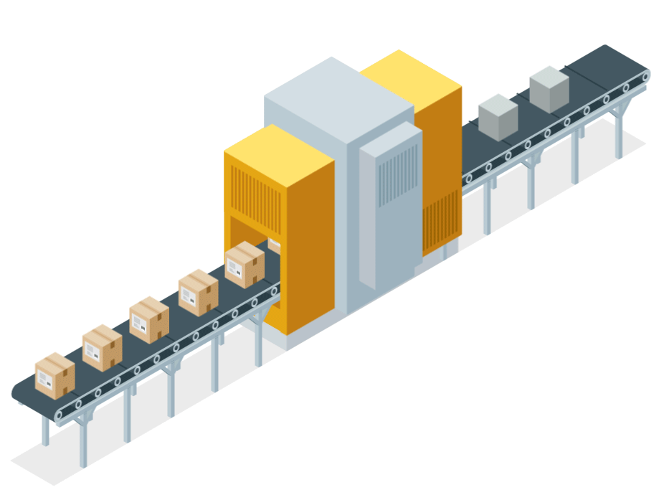

Introduction
This project focuses on developing a Retail Analytics System
Using real-world Walmart operational
and sales data, the project will explore
How data-driven decisions can improve
profitability, reduce stockouts, and
maximize sales.
insights and analytical capabilities that revolutionize the vast data the SCM industry holds.

Slide 4
Background
What is it about?
The dataset covers the period from January to September 2024 and contains information on products, customers, inventory, stores, promotions, holidays, and weather.
2. Why does it matter?
Each transaction reflects real purchasing behavior influenced by pricing, seasonality, and external factors.
The focus is to transform raw data into actionable insights and build a time-series model to forecast future sales.

Slide 5



Data Sources
Dataset: Walmart Sales & Operations Data
Size: 5,000 rows x
28 columns
Timeframe: YTD 2024

Slide 6
Research Questions
Which products, stores, and categories show the highest and lowest sales performance?
How do promotions, holidays, customer loyalty, and weather conditions affect purchasing behavior?
Can we forecast weekly sales for the upcoming year (2025) using previous year transaction data?
Which engineered or original features have the strongest influence on predicting retail demand?

Slide 7
Expected Outcomes
Insights on how pricing, promotions, weather, holidays, and customer segments drive demand.
Accurate sales forecasts for 2025 using advanced time-series and regression models.
Product-level trend analysis to support store managers’ decisions.
A Streamlit dashboard for interactive exploration, allowing users to filter products, stores, categories, and forecast values.

Slide 8
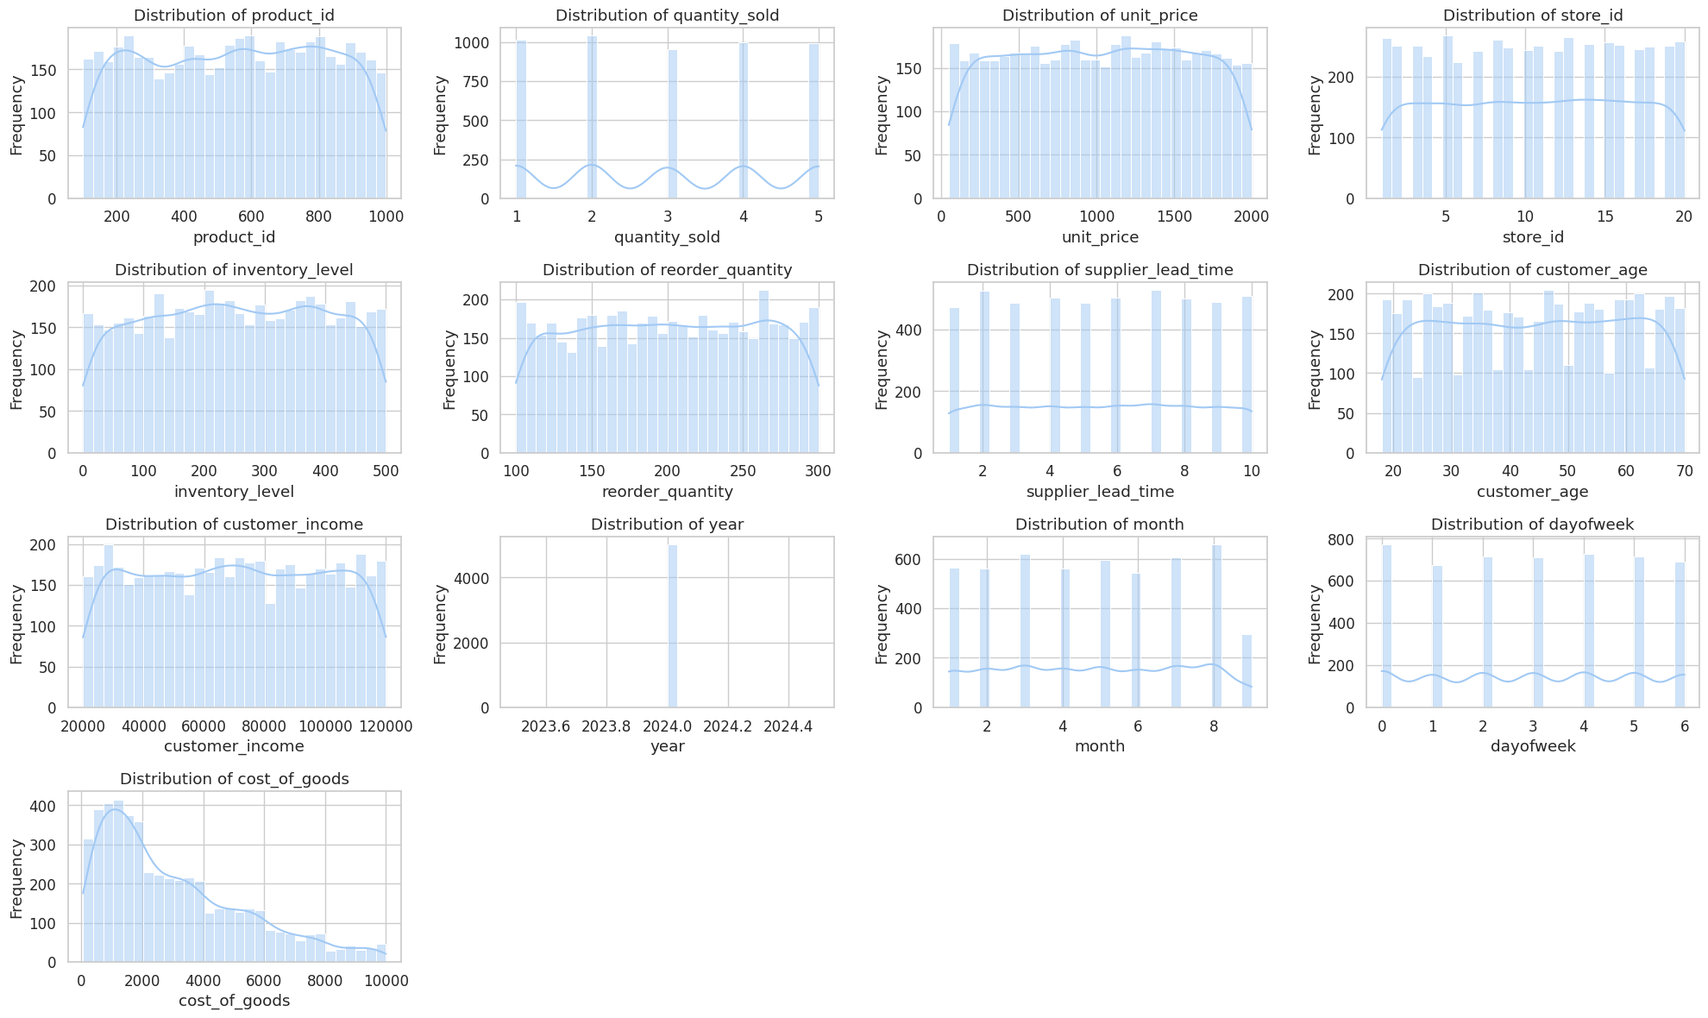
EDA: Univariate Analysis
Univariate EDA (individual features): To understand distributions, skewness, and outliers.

Slide 9
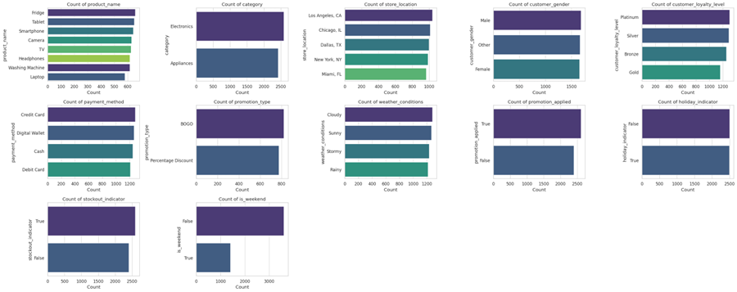
Categorical Variables
To see the balance of categories like gender, loyalty level, store location, etc.

Slide 10
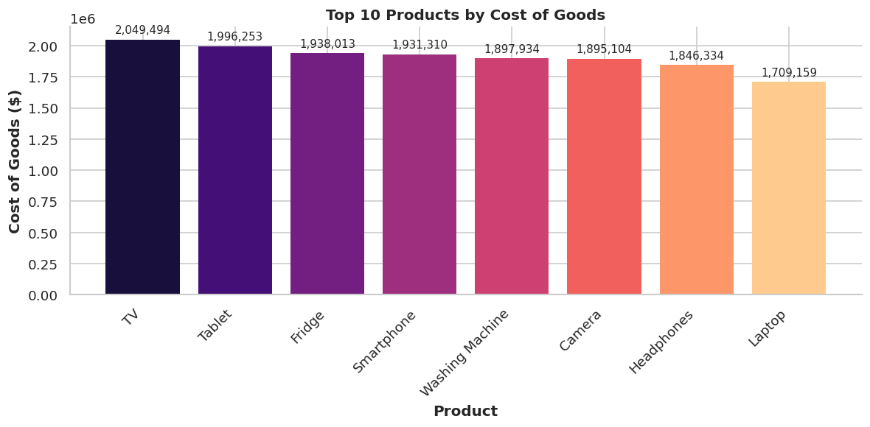
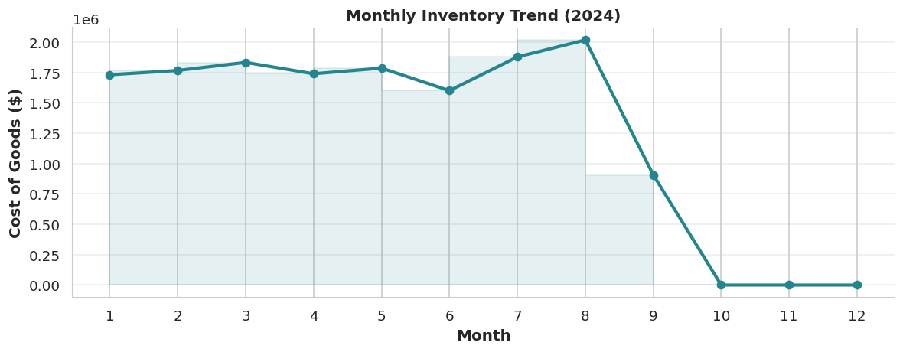
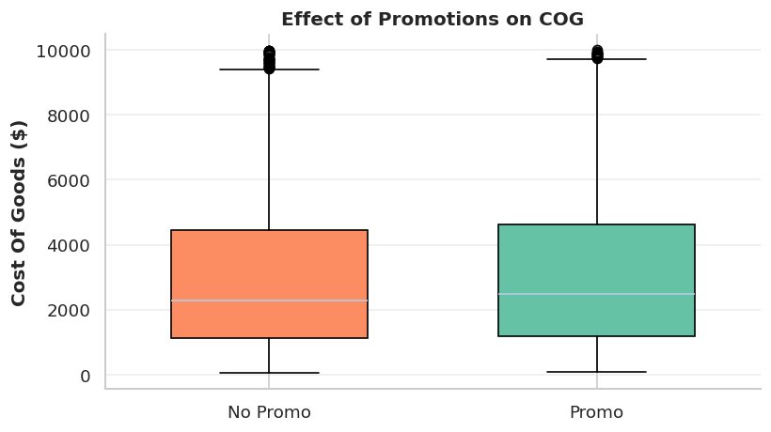
Bivariate EDA

Slide 11
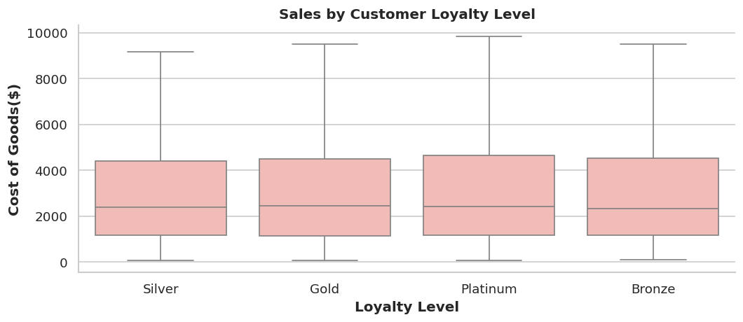
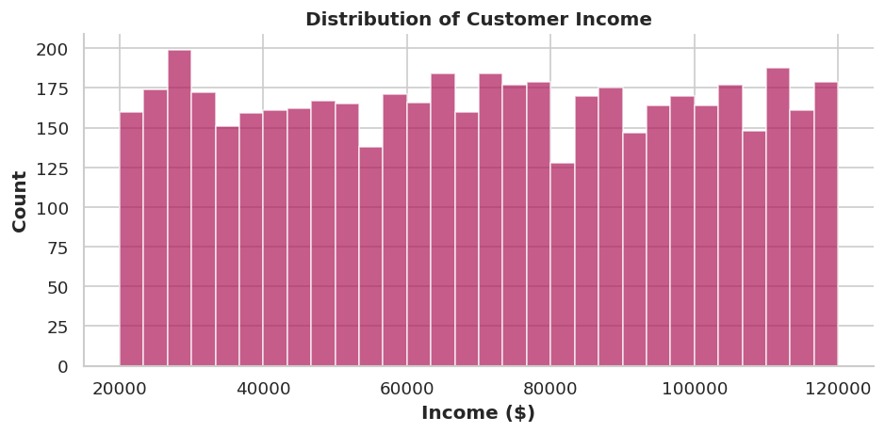
Customer Analysis
Notes:
Good [evening], everyone.
It manages the flow of goods and services, from raw materials to delivering the final product to consumers.
The supply chain is a complex network involving suppliers, manufacturers, distributors, and retailers. A disruption at any point can impact costs, timelines, and overall customer satisfaction, making effective management essential for success.
Now, let’s talk about big data. Over the years, organizations have started collecting massive amounts of data through sensors, inventory systems, and customer feedback. Big data technologies allow businesses to analyze this information to gain valuable insights
In short, big data is revolutionizing SCM by transforming raw data into actionable insights. It’s not just about managing supply chains anymore—it’s about making them smarter and more resilient.
This combination of SCM and big data is what we’ll explore further in this presentation.

Slide 12
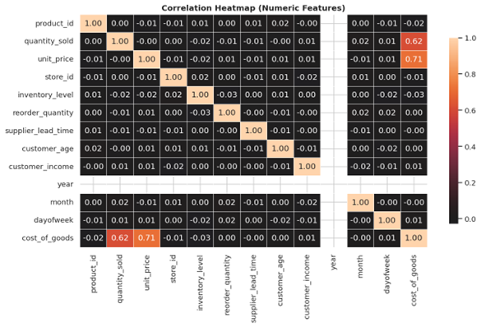
Correlation Heatmap
Strong Positive Correlation: There is a strong positive correlation between quantity_sold and cost_of_goods, which is expected as cost_of_goods is calculated using quantity_sold and unit_price.

Slide 13
Dataflow Diagram
Walmart CSV
(5,000 rows)
Data Cleaning
Feature Engineering
• Month/Week/DoW
• Moving Avg
Daily Aggregation
219 train / 54 test
Model Training
Generate Forecast for next year

Slide 14
Model Training
Selected models:
• Linear Regression, Ridge Regression, Gradient Boosting, and SARIMA.
Reasoning:
Linear Regression: Captures clear linear trends and simple time-based patterns.
Training Approach:
Trained and compared all four models on the same dataset.
Evaluation Metrics:
MAE and MAPE were used to assess performance.
• Ridge Regression: Similar to Linear Regression but includes a penalty to prevent overfitting when using many features.
• Gradient Boosting: Builds multiple small decision trees and combines them for improved accuracy.
• SARIMA: Designed for time series data; captures seasonality and trends
• Split data into training and testing periods.
• Evaluated model performance based on predictive accuracy and stability.

Slide 15
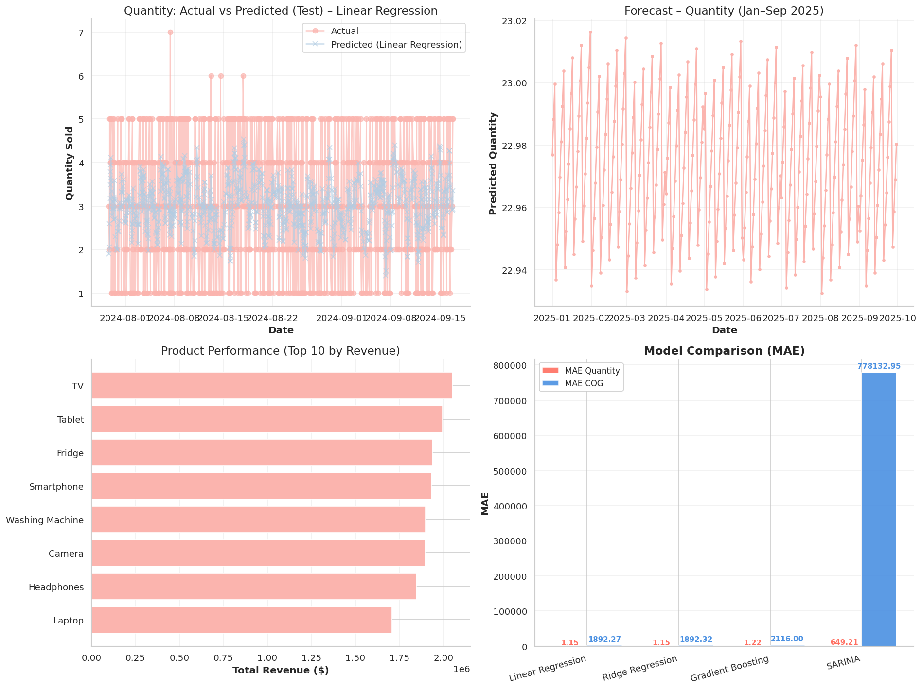
Predicted Forecast
Notes:
Good [evening], everyone.
It manages the flow of goods and services, from raw materials to delivering the final product to consumers.
The supply chain is a complex network involving suppliers, manufacturers, distributors, and retailers. A disruption at any point can impact costs, timelines, and overall customer satisfaction, making effective management essential for success.
Now, let’s talk about big data. Over the years, organizations have started collecting massive amounts of data through sensors, inventory systems, and customer feedback. Big data technologies allow businesses to analyze this information to gain valuable insights
In short, big data is revolutionizing SCM by transforming raw data into actionable insights. It’s not just about managing supply chains anymore—it’s about making them smarter and more resilient.
This combination of SCM and big data is what we’ll explore further in this presentation.

Slide 16
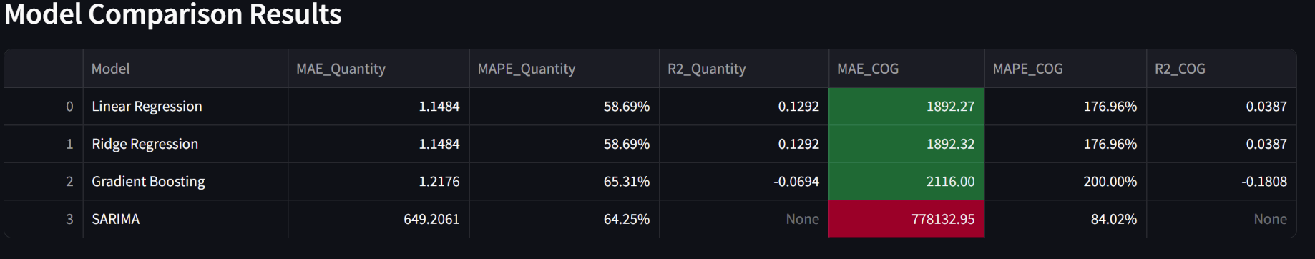
Model Comparison
MAPE (Percentage Error):
Linear & Ridge Regression (58.7%) achieve the lowest percentage errors → indicating stable and consistent predictions.
Gradient Boosting (65%) slightly higher → some overfitting due to limited data.
SARIMA (84%) shows moderate performance → affected by short time span and lack of seasonality data.
MAE (Absolute Error):
Linear & Ridge Regression show the smallest MAE (~$1,892) → strong baseline accuracy for daily sales forecasts.
Gradient Boosting slightly worse (~$2,116) → tried to capture noise rather than trend.
SARIMA shows very high MAE (~$778K) → trained on limited time-series data, not ideal for short datasets.
Overall Interpretation:
Linear Regression performs best overall — captures clear linear trends and simple patterns.
Ridge Regression prevents overfitting while maintaining similar accuracy.
Gradient Boosting overfits due to limited data and short time span.
SARIMA is better suited for long-term seasonal forecasting with 2+ years of data.

Slide 17

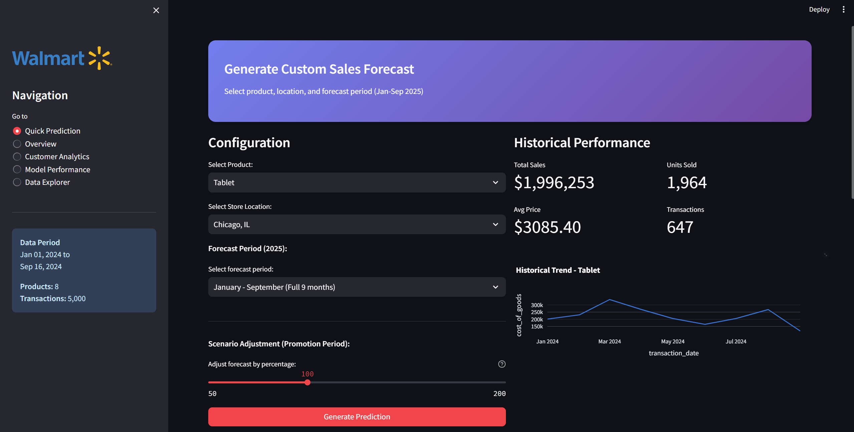
Streamlit App Overview
Created an interactive Streamlit dashboard to help store owners explore sales trends and forecast demand.
Streamlit Link: (https://umbc-data606-capstone-sruthi-kapudasi-walmart-sales.streamlit.app/)
Users can select a product, select a store, and instantly view:
Historical trends
Forecasted demand
Inventory insights and stock risk
Built using Plotly charts for better
visualization.
Notes:
Good [evening], everyone.
It manages the flow of goods and services, from raw materials to delivering the final product to consumers.
The supply chain is a complex network involving suppliers, manufacturers, distributors, and retailers. A disruption at any point can impact costs, timelines, and overall customer satisfaction, making effective management essential for success.
Now, let’s talk about big data. Over the years, organizations have started collecting massive amounts of data through sensors, inventory systems, and customer feedback. Big data technologies allow businesses to analyze this information to gain valuable insights
In short, big data is revolutionizing SCM by transforming raw data into actionable insights. It’s not just about managing supply chains anymore—it’s about making them smarter and more resilient.
This combination of SCM and big data is what we’ll explore further in this presentation.

Slide 18
Future Enhancements
Scale forecasting to multiple years and wider product categories.
Expand the dataset to include multiple years to capture stronger seasonal patterns.
Implement Prophet, Temporal Fusion Transformer (TFT), LSTM/GRU, and Informer for long-range forecasting.
Compare performance against classical models like SARIMA.
Notes:
Good [evening], everyone.
It manages the flow of goods and services, from raw materials to delivering the final product to consumers.
The supply chain is a complex network involving suppliers, manufacturers, distributors, and retailers. A disruption at any point can impact costs, timelines, and overall customer satisfaction, making effective management essential for success.
Now, let’s talk about big data. Over the years, organizations have started collecting massive amounts of data through sensors, inventory systems, and customer feedback. Big data technologies allow businesses to analyze this information to gain valuable insights
In short, big data is revolutionizing SCM by transforming raw data into actionable insights. It’s not just about managing supply chains anymore—it’s about making them smarter and more resilient.
This combination of SCM and big data is what we’ll explore further in this presentation.

Slide 19
Thank You!
QUESTIONS?

